Slide 1
Source of most materials:
Xiwei Xu, Ingo Weber, and Mark Staples. Architecture for Blockchain Applications. Springer, 2019

Slide 2
Agenda
Part 1: Course Summary
Lecturers & Tutors
Learning Outcomes
Course Outline
Assessments
Part 2: Blockchain Basics
Blockchain & DLT concepts
Decentralisation & consensus
Transactions, blocks, & ledger structures
Designing blockchain-based systems
Notes:
In part 1 of this lecture – I will give you a course summary.
I guess we will first have to introduce ourselves, the teaching team.
Then, we will talk about the learning outcomes, course outline and assessment structure.
In part 2 of the lecture – which will be in a separate slidedeck
Lam – one of the lecturers from the teaching team will give you the basics of the blockchains, going through the foundations of the technology.

Slide 3




Overview of Blockchain Research at Data61
Supply chains
Resource handling (energy, water, land, titles, ESG)
FinTech
International trade
DOMAINS
Designing trustworthy systems using blockchains
Architecting blockchain-based applications
Distributed Ledger Technologies
Blockchain platforms
Smart contracts
Tokenisation
Identifying design trade-offs
Identifying technical risks & opportunities
Formal & empirical evaluation of blockchain-based systems
Tools & processes
GOALS
TECHNOLOGY
OUTCOMES
Software Engineering & Architecture
Business Process Management
Cyber Security & Privacy
Distributed Systems
PRINCIPLES
Notes:
But of course what is more important to know is that the research group the current teaching team members are from is very well known for their research in blockchains.
Since the early stages of blockchain development, Data61 has been involved in research into blockchains. In particular, the research group that Dilum and Lam are part of received a national award for contributions made to advancing blockchain technology.
Their research focused on software engineering and architecture issues in using blockchains to build systems and applications,
Deeply thinking about possible design options and trade-offs in each design option.
In fact, this course aims to motivate you to think about similar issues. We want you to not only become a competent blockchain developer.
But also a blockchain software engineer who can think through good design options and identify pros and cons of each so that you can build a well-engineered blockchain system.

Slide 4
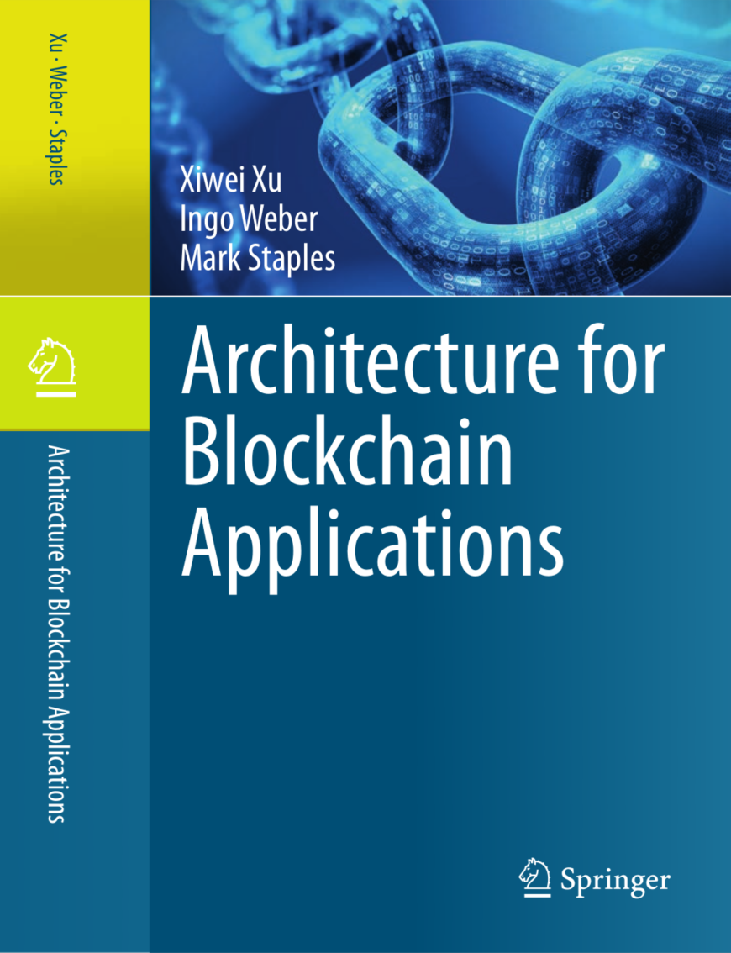
Textbook – Architecture for Blockchain Applications
Xiwei Xu, Ingo Weber, Mark Staples Architecture for Blockchain Applications Springer, 2019
Supplementary readings
Some additional notes on slides
Notes:
This book discusses all the important issues of building blockchain applications from software engineering and architecture point of views.
Sherry (the lead author) was the lecturer-in-charge of this course before and taught this course for 3 years. You will meet Dr. Mark Staples later in one of the guest lectures.
The course content closely follows the textbook, except for more recent topics. The book should be available from the UNSW library.

Slide 5
Course Structure
Notes:
OK, let’s look at briefly how the course is structured in terms of the weekly activities.

Slide 6
Learning Outcomes
On completion of the course, you will be able to:
explain the principles of blockchain & its roles in an application architecture
assess the suitability of blockchains to solve a constrained problem
design blockchain-based software architectures
make functional and non-functional trade-offs for blockchain-based applications
build small applications on a blockchain
Notes:
First … the learning outcomes. These are what we hope you will have learned at the end of the course.
So after the course, we want you to be able to:
we want you to understand the principles of blockchains and explain them clearly, and the roles the technology can play in an application architecture
You should be able to decide when blockchains are suitable in an application and how to design applications using blockchains
you should be able to draw up pros and cons of a design in terms of functional and non-functional properties of the system and make a decision based on the trade-offs from the analysis.
Finally, develop small, but non-trivial applications on blockchains. That is, we would like you to have some hands-on skills after this course.

Slide 7
Course Outline
 | Date | Lecturer | Monday | Wednesday | Assessment
1 | May 29 & 31 | Lam Helen Dilum | Introduction Blockchain basics | Blockchain platforms | Project 1 release Project 2 release
2 | June 5 & 7 | Lam Dilum | Smart contracts & oracles | Software architecture basics
3 | June 12 & 14 | Dilum | Public holiday Guest lecture 1 | Blockchain in software architecture | Project 1 submission Project 2 Team & Idea Selection
4 | June 19 & 21 | Dilum | Decentralised application design process | Blockchain taxonomy | Quiz 1
5 | June 26 & 28 | Dilum | Blockchain application patterns | Project 2 – Presentation 1 (use case, requirements, & high-level design) | Project 2 – Presentation 1
Notes:
Now let's look at the weekly schedule of the course in terms of the topics and assignment activities.
This time offering has changed a bit from the past offerings of this course. The main change is the topics and their depth of coverage.
Week 1
This week, after the course intro, you will learn the basics of blockchains and the various problems you need to understand in applying blockchain technology.
You will also learn the different blockchain platforms available currently.
Both Projects 1 & 2 are leased this week, but they are due on different dates. Note that Project 2 has 2 assessment components
Week 2
We start the week with the basics of smart contracts – the programming paradigm that everybody uses to build applications on blockchains
Actually, this smart contract topic will be the core of your first project. You will be guided through how to write your first smart contract, and how to make it run on a blockchain – then we will give you a few extra activities you need to complete.
As mentioned, the course discusses a lot of software architecture-related topics, so starting from Week 2, we will introduce some basics of the software architecture area and related concepts, and then we will talk about software architecture topics in the context of blockchains.
Week 3
Monday Week 3 is a public holiday. Rather than scheduling an extract lecture during Week 6, we will upload 2 pre-recorded guest lectures
Then on 2nd day, we will discuss the role of blockchain in a software architecture
Week 4
The taxonomy will allow you to break down the design choice issues into different categories and available options. Having something like this allows you to evaluate and compare different design choices clearly.
Next we discuss about the process of developing blockchain-based applications. And also how you may decide if blockchain technology is suitable for given situations or not.
Week 5
We will discuss design patterns. Design patterns in software engineering is introduced to provide a good solution to recurring or common problems in software development. We will show you some application design patterns that involve blockchains and what sort of problems they tackle. Hopefully, you will be able to identify some of them in your own projects.
In the second lecture, we will ask you to present your project 2 design solution to us.

Slide 8
Course Outline (Cont.)
 | Date | Lecturer | Monday | Wednesday | Assessment
6 | Break
7 | July 10 & 12 | Helen | Performance Reliability | Security Privacy
8 | July 17 & 19 | Dilum | Smart contract testing | Interoperability | Quiz 2
9 | July 24 & 26 | Helen | Cost Guest lecture 2 | Project 2 – Presentation 2 (design & demo) | Project 2 – Presentation 2
10 | July 31 & Aug 2 | Helen | Blockchain governance | Guest lecture 3 Summary | Project 2 submission
Notes:
Week 6
This is a quiet week – so you can catch up with stuff.
Week 7
We will talk about the performance of blockchain-based systems, general issues and how to, to measure when we talk about performance issues in blockchains.
Next, we move onto topis what we call non-functional properties of software, topics like security, reliability, privacy, etc.
We will talk about testing smart contracts, again things to consider when testing smart contracts, how to test, etc.
Week 8
This week’s focus on privacy issues around blockchains
We will also talk about other aspects like reliability and cost of operating and transacting on a blockchain
Week 9
We start the week with a discussion on how blockchains can interoperate with other blockchains and conventional/centralised systems
in the second part of the week, we will ask you to present the final outcome of your project to us.
A guest lecture is also scheduled
Week 10
In the final week, we talk about the governance of blockchain platforms and blockchain-based applications. For example, we will talk about the emerging form of governance called DAO (decentralised autonomous organisations)
We will summarise the course and give you some sample questions for the final exam.

Slide 9
Assessments
Assessment Title | Assessment Type | Marks
Projects (2) | Assignment 2 assignments where you will analyse & implement use cases using blockchains and smart contracts Project 1 individual, Project 2 group (4 students) | 15 + 30
Quizzes (2) | Quiz Test 2 online quizzes on material covered up to that point | 10 x 2 = 20
Final Exam | Central online open book exam via Inspera A written take-home examination, testing all course content Students must obtain a passing grade on the exam to pass the course (i.e., < 50% of the exam points means failing the course) | 35
Notes:
There are 3 assessment components:
Projects
Project 1 is an individual assessment where you will develop a smart contract and add some additional functionalities. This project accounts for 15 marks
2nd project will be a group activity. The main idea is for you to build a non-trivial blockchain application from scratch, applying the design concepts you have learned in the course. There will be 2 checkpoints for this project, the first one, you need to show us your design and requirement analysis of your application, and then in the final checkpoint, you will be presenting the complete working application to us. This project accounts for 30 marks split as 16 + 14
Quizzes
There will be 2 online quizzes on Week 4 and 8.
It consists of a mix of MCQ, True/False, short answer, etc., questions
Final exam
It will be a 24-hour online open book exam conducted via Inspera
While is exam is open for so long, an average student should be able to complete it within 3 hours
You will be given a blockchain-related research paper and you need to answer a bunch of questions about its software architecture and critically evaluate that
Note that you must obtain a passing grade on the exam to pass the course (i.e., < 50% of the exam points means failing the course)

Slide 10
Tutorials, Labs, & Class Consultations
 | Date | Topic
1 | May 29 & 30 | Lab 1
2 | June 5 & 6 | Tutorial 1
3 | June 12 & 13 | Lab 2
4 | June 19 & 20 | Tutorial 2
5 | June 26 & 27 | Project 2-1
6 | Break
7 | July 10 & 11 | Lab 3
8 | July 17 & 18 | Lab 4
9 | July 24 & 25 | Project 2-2
10 | July 31 & Aug 1 | Review
Tutorials & Labs
Monday 3:00 - 5:00pm
Tuesday 9:00 - 11:00am, 11:00am - 1:00pm, 2:00 - 4:00pm, & 4:00 - 6:00pm
Class consultations
Lectures – Immediately after class or by appointment
TAs – During tutorials/labs or by appointment
Ed Discussion forums
Notes:
We will have a mix of tutorials and labs on following sloys
Monday 3:00 - 5:00pm
Tuesday 9:00 - 11:00am, 11:00am - 1:00pm, 2:00 - 4:0pm, & 4:00 - 6:00 pm
5 of those slots will be more like a self-guided lab session with TA support. So bring your laptop
2 other slots will be tutorial sessions where we will discuss various software design aspects
2 Project 2 evaluation sessions for Presentation 1 and 2
Class consultations
Lectures – Immediately after class or by appointment as most lecturers are from the industry
TAs – During tutorials/labs or by appointment
Use Moodle Forums for basic questions
It will help others with similar questions too
Also, you may answer each others questions

